Slide 1

DEPARTMENT OF ARTIFICIAL INTELLIGENCE AND DATA SCIENCE
Vision
To impart international quality education, promote collaborative research and graduate industry-ready engineers in the domain of Artificial Intelligence and Data Science to serve the society.

Slide 2

Python’s String Class
Strings are arrays of bytes representing Unicode characters. However, Python does not have a character data type, a single character is simply a string with a length of 1.
Accessing characters in Python
In Python, individual characters of a String can be accessed by using Index.
String1 = "GeeksForGeeks"
# Printing First character
print("\nFirst character of String is: ")
print(String1[0])
# Printing Last character
print("\nLast character of String is: ")
print(String1[-1])

Slide 3
# Python Program to demonstrate String slicing
# Creating a String
String1 = "GeeksForGeeks"
print("Initial String: ")
print(String1)
# Printing 3rd to 12th character
print("\nSlicing characters from 3-12: ")
print(String1[3:12])
# Printing characters between
# 3rd and 2nd last character
print("\nSlicing characters between " +
"3rd and 2nd last character: ")
print(String1[3:-2])
Slicing characters from 3-12:
ksForGeek
Slicing characters between 3rd and 2nd last character:
ksForGee

Slide 4
Deleting/Updating from a String
In Python, Updation or deletion of characters from a String is not allowed. This is because Strings are immutable.
Although deletion of the entire String is possible with the use of a built-in del keyword.
Only new strings can be reassigned to the same name.
String1 = "Hello, I'm a RITANS"
print("Initial String: ")
print(String1)
# Updating a character of the String
String1[2] = ‘p’
print(String1)
del String1[2]
# Deleting a String with the use of del
del String1
TypeError: ‘str’ object does not support item assignment
TypeError: ‘str’ object doesn’t support item deletion

Slide 5
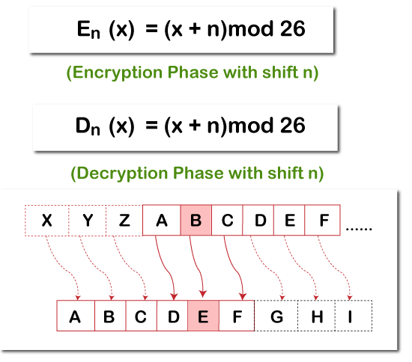
Application of strings and lists
cryptography, the science of secret messages.
encryption, which takes a message, called the plaintext, and converts it into a scrambled message, called the ciphertext.
Decryption, which takes a ciphertext and turns it back into its original plaintext
Plaintext Shift by 3
CAB
FDE
ciphertext

Slide 6
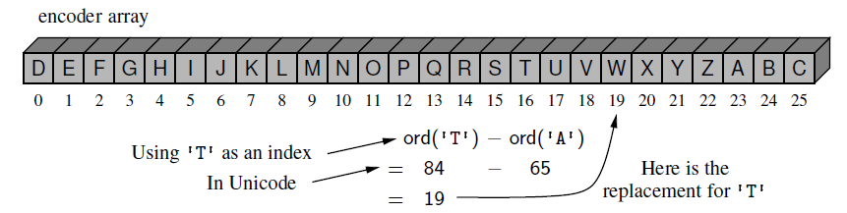
encoder[k] = chr((k + shift) % 26 + ord('A'))
LOVE
(11 ,14 ,21 , 4)
['A', 'B', 'C‘,'D', 'E', 'F', 'G', 'H', 'I', 'J', 'K', 'L', 'M', 'N', 'O', 'P', 'Q', 'R', 'S', 'T', 'U', 'V', 'W', 'X', 'Y', 'Z']
['D', 'E', 'F', 'G', 'H', 'I', 'J', 'K', 'L', 'M', 'N', 'O', 'P', 'Q', 'R', 'S', 'T', 'U', 'V', 'W', 'X', 'Y', 'Z', 'A', 'B', 'C']
['A', 'B', 'C‘,'D', 'E', 'F', 'G', 'H', 'I', 'J', 'K', 'L', 'M', 'N', 'O', 'P', 'Q', 'R', 'S', 'T', 'U', 'V', 'W', 'X', 'Y', 'Z']
['X', 'Y', 'Z', 'A', 'B', 'C', 'D', 'E', 'F', 'G', 'H', 'I', 'J', 'K', 'L', 'M', 'N', 'O', 'P', 'Q', 'R', 'S', 'T', 'U', 'V', 'W']
ORYH
(14 ,17, 24, 7)
decoder[k] = chr((k - shift) % 26 + ord('A'))

Slide 7
class CaesarCipher:
"""Class for doing encryption and decryption using a Caesar cipher."""
def __init__(self, shift):
"""Construct Caesar cipher using given integer shift for rotation."""
encoder = [None] * 26 # temp array for encryption
decoder = [None] * 26 # temp array for decryption
for k in range(26):
encoder[k] = chr((k + shift) % 26 + ord('A'))
decoder[k] = chr((k - shift) % 26 + ord('A'))
self._forward = ''.join(encoder) # will store as string
self._backward = ''.join(decoder) # since fixed

Slide 8
def encrypt(self, message):
"""Return string representing encripted message."""
return self._transform(message, self._forward)
def decrypt(self, secret):
"""Return decrypted message given encrypted secret."""
return self._transform(secret, self._backward)
def _transform(self, original, code):
"""Utility to perform transformation based on given code string."""
msg = list(original)
for k in range(len(msg)):
if msg[k].isupper():
j = ord(msg[k]) - ord('A') # index from 0 to 25
msg[k] = code[j] # replace this character
return ''.join(msg)

Slide 9
if __name__ == '__main__':
cipher = CaesarCipher(3)
message = "LOVE"
#message = "THE EAGLE IS IN PLAY; MEET AT JOE'S."
coded = cipher.encrypt(message)
print('Secret: ', coded)
answer = cipher.decrypt(coded)
print('Message:', answer)
Secret: ORYH.
Message: LOVE
Time complexity
O(n) where n is the size of the given string. Here we traverse the whole string char by char and change the current character in constant time

Slide 10
Pattern matching : Ex: brute-force algorithm
In Pattern matching, search() method searches the string it is passed for any matches.
def search(pat, txt):
M = len(pat)
N = len(txt)
for i in range(N - M + 1): # A loop to slide pat[] one by one */
j = 0
while(j < M) and txt[i+j]==pat[j]: # For current index i, check for pattern match */
j += 1
if (j == M):
print("Pattern found at index ", i)
# Driver Code
if __name__ == '__main__':
txt = "AABAACAADAABAAABAA"
pat = "AABA"
search(pat, txt)
runs in O(mn) time case, because we consider the n−m+1 possible starting indices for the pattern, and we spend O(m) time at each starting position, checking if the pattern matches

Slide 11

Composing Strings
It compose a set of character through repeated concatenation,
letters = ‘ ‘ # start with empty string
for c in document:
if c.isalpha( ):
letters += c # concatenate alphabetic character
sum 1+2+3+· · ·+n times need to run, and therefore time
Optimized code
temp = [ ] # start with empty list
for c in document:
if c.isalpha( ):
temp.append(c) # append alphabetic character
letters = .join(temp) # compose overall result
Time complexity - O(n)

Slide 12
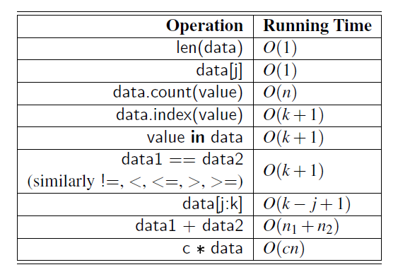
Python’s List and Tuple Classes

Slide 13
Class assignment
Write a python program to
Missing number in array
Kth smallest element
Find duplicates in an array
Sort an array of 0s, 1s and 2s
Majority Element
Peak element
Merge two sorted arrays
https://practice.geeksforgeeks.org/explore?page=1&company[]=Amazon&category[]=Arrays&sortBy=submissions

Slide 14

Linked list
A singly linked list is a collection of nodes that collectively form a linear sequence. Each node stores a reference to an object that is an element of the sequence, as well as a reference to the next node of list
An important property of a linked list is that it does not have a determined fixed size
Example of a singly linked list whose elements are strings indicating airport codes.
The list instance maintains a member named head that identifies the first node of the list, and another member named tail that identifies the last node of the list. The None object is denoted as Ø.

Slide 15
traversing
By starting at the head, and moving from one node to another by following each node’s next reference to reach the tail of the list.
The next reference of a node can be viewed as a link or pointer to another node,
link hopping or pointer hopping
The process of traversing a list is also known as link hopping or pointer hopping.

Slide 16
Advantages over arrays 1) Dynamic size 2) Ease of insertion/deletion
Drawbacks:
1) Random access is not allowed. We have to access elements sequentially starting from the first node(head node). So we cannot do binary search with linked lists efficiently with its default implementation
2) Extra memory space for a pointer is required with each element of the list. 3) Not cache friendly. Since array elements are contiguous locations, there is locality of reference which is not there in case of linked lists.

Slide 17

A node can be added in three ways 1) At the front of the linked list 2) After a given node. 3) At the end of the linked list.
# Node class
class Node:
# Function to initialize the node object
def __init__(self, data):
self.data = data # Assign data
self.next = None # Initialize next as null
# Linked List class
class LinkedList:
# Function to initialize the Linked List object
def __init__(self):
self.head = None

Slide 18
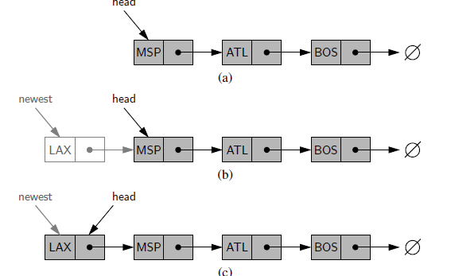
Inserting an Element at the Head of a Singly Linked List
Algorithm add first(L, new_data):
newest = Node(new_data) #create new node instance with data
newest.next = L.head # new node’s next to reference the old head node
L.head = newest #set variable head to reference the new node
L.size = L.size+1 #increment the node count

Slide 19
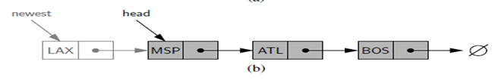
# Node class
class Node:
# Function to initialize the node object
def __init__(self, data):
self.data = data # Assign data
self.next = None # Initialize next as null
# Linked List class
class LinkedList:
# Function to initialize the Linked List object
def __init__(self):
self.head = None
def add_firstt(self, new_data):
# 1 & 2: Allocate the Node & Put in the data
new_node = Node(new_data)
# 3. Make next of new Node as head
new_node.next = self.head
# 4. Move the head to point to new Node
self.head = new_node
Time complexity of push() is O(1)

Slide 20
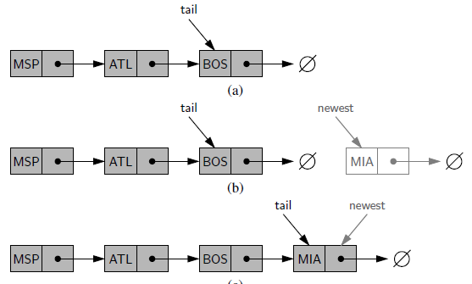
Inserting an Element at the Tail or last of a Singly Linked List
Algorithm add_last(L, new_data):
newest = Node(new_data) {create new node instance }
newest.next = None {set new node’s next to reference the None object}
L.tail.next = newest {make old tail node point to new node}
L.tail = newest {set variable tail to reference the new node}
L.size = L.size+1 {increment the node count}

Slide 21
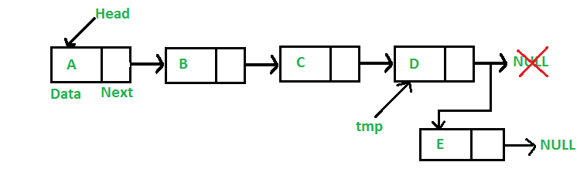
def add_last (self, new_data):
# 1. Create a new node # 2. Put in the data # 3. Set next as None
new_node = Node(new_data)
# 4. If the Linked List is empty, then make the # new node as head
if self.head is None:
self.head = new_node
return
# 5. Else traverse till the last node
last = self.head
while (last.next):
last = last.next
# 6. Change the next of last node
last.next = new_node
Time complexity of append is O(n)

Slide 22
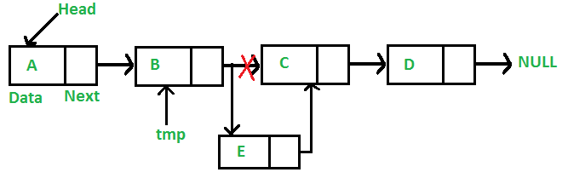
Add a node after a given node
def insertAfter(self, prev_node, new_data):
# 1. check if the given prev_node exists
if prev_node is None:
print("The given previous node must in LinkedList.")
return
# 2. Create new node & # 3. Put in the data
new_node = Node(new_data)
# 4. Make next of new Node as next of prev_node
new_node.next = prev_node.next
# 5. make next of prev_node as new_node
prev_node.next = new_node

Slide 23
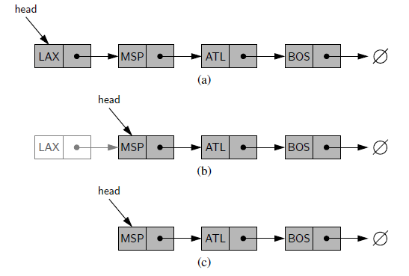
Removing an Element at first from a Singly Linked List
Algorithm remove first(L):
if L.head is None then
print( the list is empty.)
L.head = L.head.next {make head point to next node (or None)}
L.size = L.size−1 {decrement the node count}

Slide 24
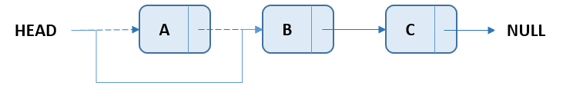
def remove_first(self):
if(self.head != None):
#1. if head is not null, create a temp node pointing to head
temp = self.head
#2. move head to next of head
self.head = self.head.next
#3. delete temp node
temp = None

Slide 25
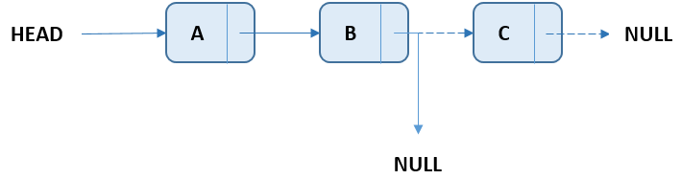
Delete the last node of the Linked List
def remove_last(self):
if(self.head != None):
#1. if head in not null and next of head is null, release the head
if(self.head.next == None):
self.head = None
else:
#2. Else, traverse to the second last element of the list
temp = self.head
while(temp.next != None):
temp = temp.next
#3. Change the next of the second last node to null and delete the last node
lastNode = temp.next
temp.next = None
lastNode = None

Slide 26
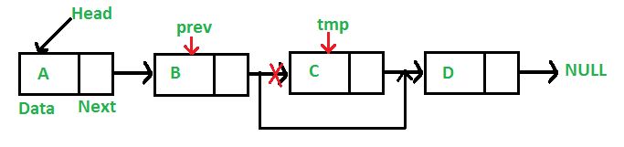
def deleteNode(self, key): # Store head node
temp = self.head
# If head node itself holds the key to be deleted
if (temp is not None):
if (temp.data == key):
self.head = temp.next
temp = None
return
# Search for the key to be deleted, keep track of the previous node as we need to change 'prev.next'
while(temp is not None):
if temp.data == key:
break
prev = temp
temp = temp.next
# if key was not present in linked list
if(temp == None):
return
# Unlink the node from linked list
prev.next = temp.next
temp = None

Slide 27
Class assignment –linked list
Write a python program to
sort a given linked list into ascending order in python
Delete all nodes of the Linked List
Count nodes in the Linked List
Delete even nodes of the Linked List
Delete odd nodes of the Linked List
Delete alternate nodes of a Linked List
Search an element in the Linked List
Reverse the Linked List
Reverse alternate K nodes in a Singly Linked List
Inputs: 1->2->3->4->5->6->7->8->9->NULL and k = 3
Output: 3->2->1->4->5->6->9->8->7->NULL.
Swap node values of a Linked List
Finding middle element in a linked list
Merge two sorted linked lists
Identical Linked Lists

Slide 28
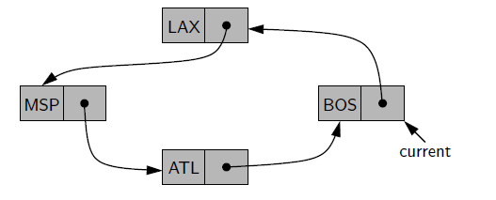
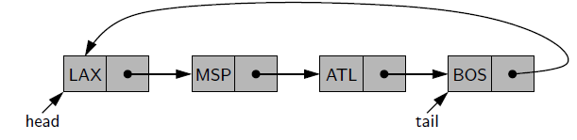
Circularly Linked Lists
In a linked list, next reference tail point back to the head of the list which do not have any particular notion of a beginning and end
class Node:
def __init__(self,data):
self.data = data;
self.next = None;
class CircularLinkedList:
# Declaring Circular Linked List
def __init__(self):
self.head = Node(None);
self.tail = Node(None);
self.head.next = self.tail;
self.tail.next = self.head;

Slide 29
# Adds new nodes to the Circular Linked List
def add(self,data):
# Declares a new node to be added
newNode = Node(data);
# Checks if the Circular Linked List is empty
if self.head.data is None:
# If list is empty then new node will be the first node to be added in the Circular Linked List
self.head = newNode;
self.tail = newNode;
newNode.next = self.head;
else:
# If a node is already present then tail of the last node will point to new node
self.tail.next = newNode;
# New node will become new tail
self.tail = newNode;
# New Tail will point to the head
self.tail.next = self.head;

Slide 30
Class assignment
Python program to create and display a Circular Linked List
Python program to sort the elements of the Circular Linked List
Python program to search an element in a Circular Linked List
Python program to remove duplicate elements from a Circular Linked List
Python Program to Convert a given Singly Linked List to a Circular List
Check if a linked list is Circular Linked List
Python program to delete a node from the middle of the Circular Linked List
Python program to delete a node from the end of the Circular Linked List
Count nodes in Circular linked list

Slide 31
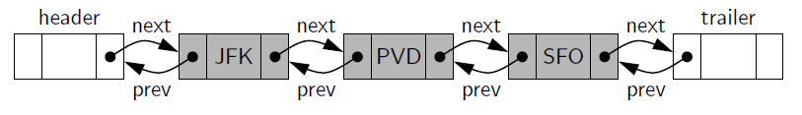
Doubly Linked Lists
A linked list in which each node keeps an explicit reference to the node before it and a reference to the node after it. Such a structure is known as a doubly linked list.
These lists perform O(1)-time update operations, including insertions and deletions at arbitrary positions within the list.
Allows us to iterate in both directions and Reversing is easy
Limitation or disadvantages
we are unable to efficiently delete a node at the tail of the list and delete an arbitrary node from an interior position of the list, because each node store an extra pointer which consumes extra memory
Operations require more time due to the overhead of handling extra pointers .
No random access of elements

Slide 32
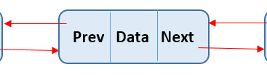
class _DoublyLinkedBase:
class _Node:
"""Lightweight, nonpublic class for storing a doubly linked node"“
__slots__ = '_element', '_prev', '_next' # streamline memory
def __init__(self, element, prev, next): # initialize node's fields
self._element = element # user's element
self._prev = prev # previous node reference
self._next = next # next node reference

Slide 33


def __init__(self):
"""Create an empty list."""
self._header = self._Node(None, None, None)
self._trailer = self._Node(None, None, None)
self._header._next = self._trailer # trailer is after header
self._trailer._prev = self._header # header is before trailer
self._size = 0 # number of elements

Slide 34
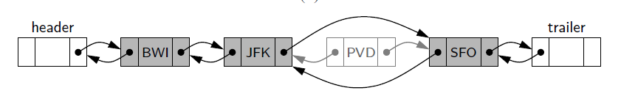
def _insert_between(self, e, predecessor, successor):
#Add element e between two existing nodes and return new node
newest = self._Node(e, predecessor, successor# linked to neighbors
predecessor._next = newest
successor._prev = newest
self._size += 1
return newest

Slide 35
def _delete_node(self, node):
#Delete nonsentinel node from the list and return its element.
predecessor = node._prev
successor = node._next
predecessor._next = successor
successor._prev = predecessor
self._size -= 1
element = node._element # record deleted element
node._prev = node._next = node._element = None # deprecate node
return element

Slide 36
def __len__(self):
"""Return the number of elements in the list."""
return self._size
def is_empty(self):
"""Return True if list is empty."""
return self._size == 0

Slide 37
Class assignment-DLL
Reverse a doubly linked list in groups of given size
Python Program to Rotate Doubly linked list by N nodes

Slide 38
References
https://www.geeksforgeeks.org/python-oops-concepts/
https://www.alphacodingskills.com/python/ds/python-delete-the-last-node-of-the-linked-list.php
Michael T. Goodrich, Roberto Tamassia, and Michael H. Goldwasser, “Data Structures and Algorithms in Python” (An Indian Adaptation), Wiley, 2021

